Slide 1
Pytorch Tutorial
By Hong Xu
Based on Chongruo Wu’s tutorial

Slide 2
Structure
Frameworks Overview: why pytorch?
Pytorch: Installation and running
Pytorch: building blocks
Pytorch: optimizer, scheduler and data loader
Pytorch: MNIST step-by-step example
Pytorch: ideal Project structure
Other resources
Tensorflow briefly: MNIST example

Slide 3
Structure
Frameworks Overview: why pytorch?
Pytorch: Installation and running
Pytorch: building blocks
Pytorch: optimizer, scheduler and data loader
Pytorch: MNIST step-by-step example
Pytorch: ideal Project structure
Other resources
Tensorflow briefly: MNIST example

Slide 4




Democratization of Deep learning
Democratization is defined as the action/development of making something accessible to everyone, to the “common masses.”
This is done through deep learning frameworks.

Slide 5
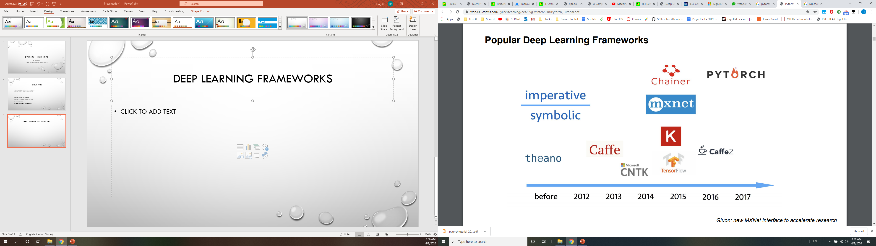
Deep Learning frameworks

Slide 6
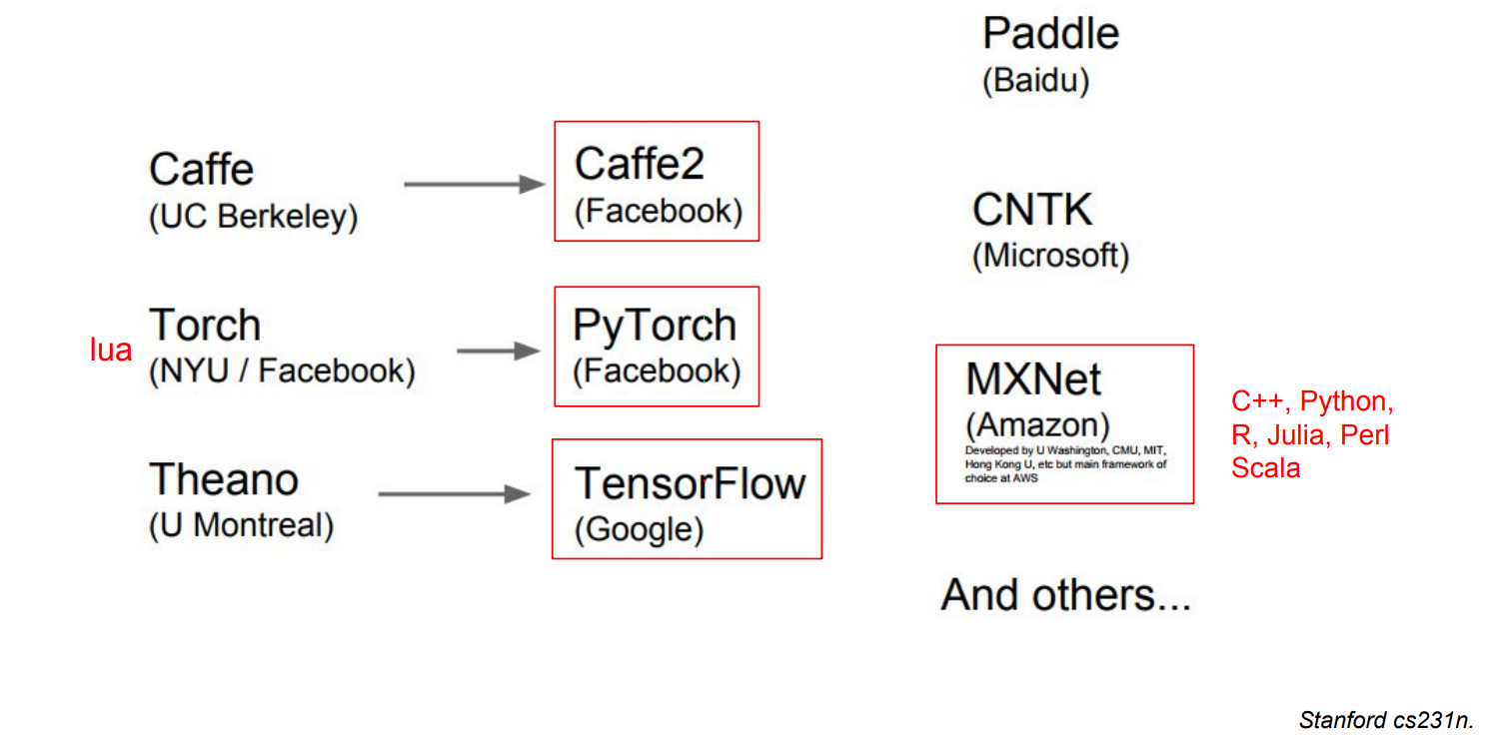
Deep Learning frameworks

Slide 7
Deep Learning frameworks
Caffe: Portable. Low level, so hard and painful.
Tensorflow: rich in functionality, but the code is hard to read (not python-like).
Keras: simplest and easiest to use. hard to implement anything sophisticated.
Pytorch: Flexible, easy to read. Might be slow for complicated programs.

Slide 8
Functionalities: Why pytorch?
Augmented tensor operations (nearly identical to numpy) Seamless interfaces with existing programs.
Automatic differentiation. The very core of Optimization based algorithms.
Parallel(CPU/GPU/TPU) and Distributed(multi-machine) Computing. Essential for large( industrial level) applications. Implemented in C++/CUDA. Highly Efficient.

Slide 9
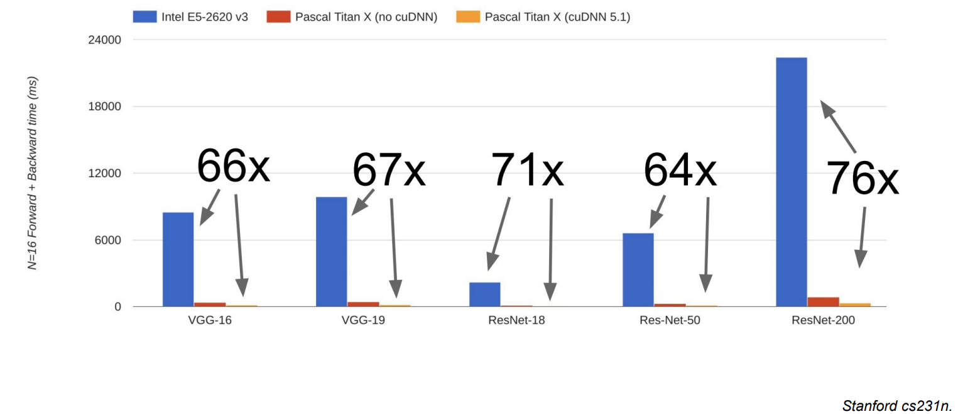
GPU use is almost imperative

Slide 10

Where to find (free) computing resources
Your own Gaming PC
CHPC ( University) , CADE (College of Engineering)
AWS/Google Cloud Platform: First time coupon.
Google Colab: Always free, equipped with GPU and TPU!

Slide 11
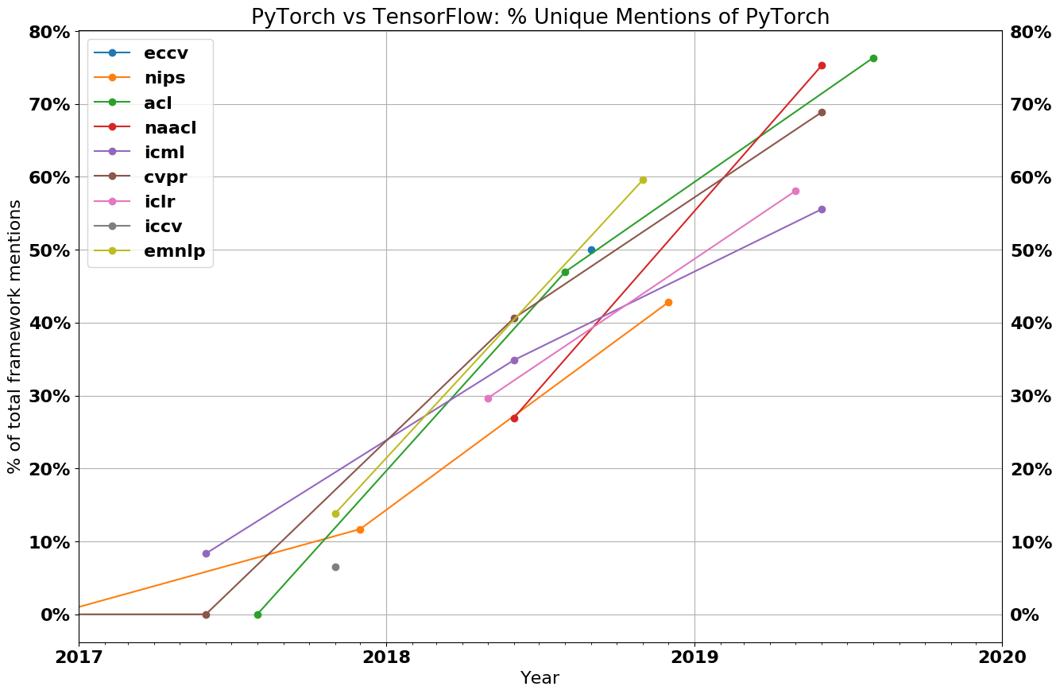
Pytorch in academia
Image from https://thegradient.pub/state-of-ml-frameworks-2019-pytorch-dominates-research-tensorflow-dominates-industry/

Slide 12
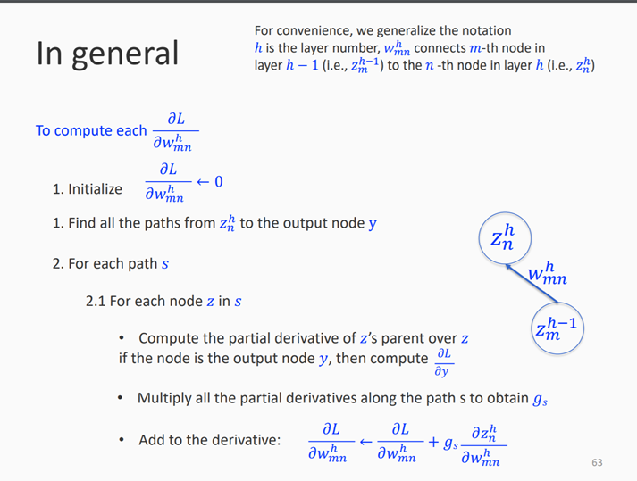
Automatic differentiation
Only operations with “sub-gradient” can be applied on Tensor
Arithmetic： +, -, *, /
Elementary functions: exp, log, max, sin, tan

Slide 13
Automatic differentiation
Only operations with “sub-gradient” can be applied on Tensor
Arithmetic： +, -, *, /
Elementary functions: exp, log, max, sin, tan
What operations are not “differentiable”?
For example: “Vanilla” sampling

Slide 14
Structure
Frameworks Overview: why pytorch?
Pytorch: Installation and running
Pytorch: building blocks
Pytorch: optimizer, scheduler and data loader
Pytorch: MNIST step-by-step example
Pytorch: ideal Project structure
Other resources
Tensorflow briefly: MNIST example

Slide 15


Pytorch: Installation
Prerequisites:
64-bit processor
64-bit Operating system
Python
GPU Prerequisites:
GPU (NVIDia preferably). More work on amd GPUs
cuda

Slide 16


Pytorch: Installation
Anaconda (recommended option):
Install anaconda
conda install pytorch torchvision cudatoolkit=10.1 -c pytorch
pip (second option):
Pip install torch torchvision (linux/mac)
Pip install torch===1.4.0 torchvision===0.5.0 –f https://download.pytorch.org/whl/torch_stable.html (windows)

Slide 17




Pytorch: running
Once installed, refer to the jupyter notebook for the rest of the tutorial.

Slide 18
Structure
Frameworks Overview: why pytorch?
Pytorch: Installation and running
Pytorch: building blocks
Pytorch: optimizer, scheduler and data loader
Pytorch: MNIST step-by-step example
Pytorch: ideal Project structure
Other resources
Tensorflow briefly: MNIST example

Slide 19
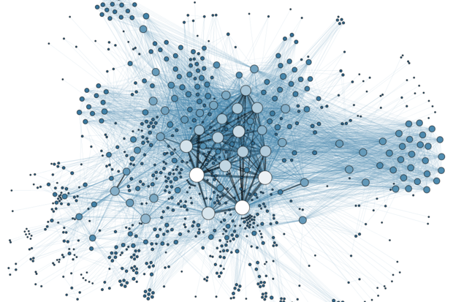


Pytorch: ideal Project structure
When starting a project
Data preparation ( processing, format )
Model Design ( pretrained, design your own model)
Training Strategy ( learning rate )

Slide 20
Pytorch: ideal Project structure
My Project structure on git
Main directory
Lib
Nets
Trainers and testers
Datasets and preprocessing
Input
Output
Src
Main.py
Preprocessing.py

Slide 21
Structure
Frameworks Overview: why pytorch?
Pytorch: Installation and running
Pytorch: building blocks
Pytorch: optimizer, scheduler and data loader
Pytorch: MNIST step-by-step example
Pytorch: ideal Project structure
Other resources
Tensorflow briefly: MNIST example

Slide 22
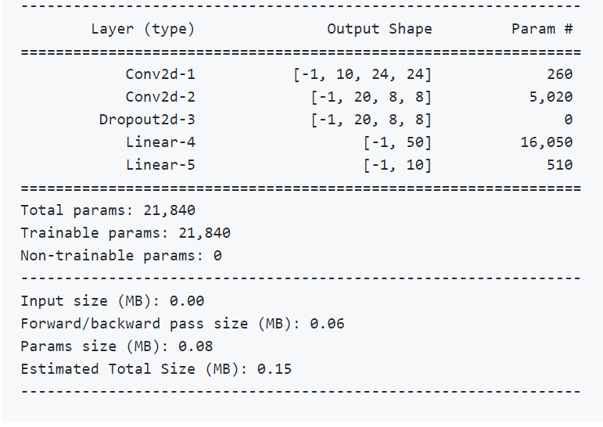
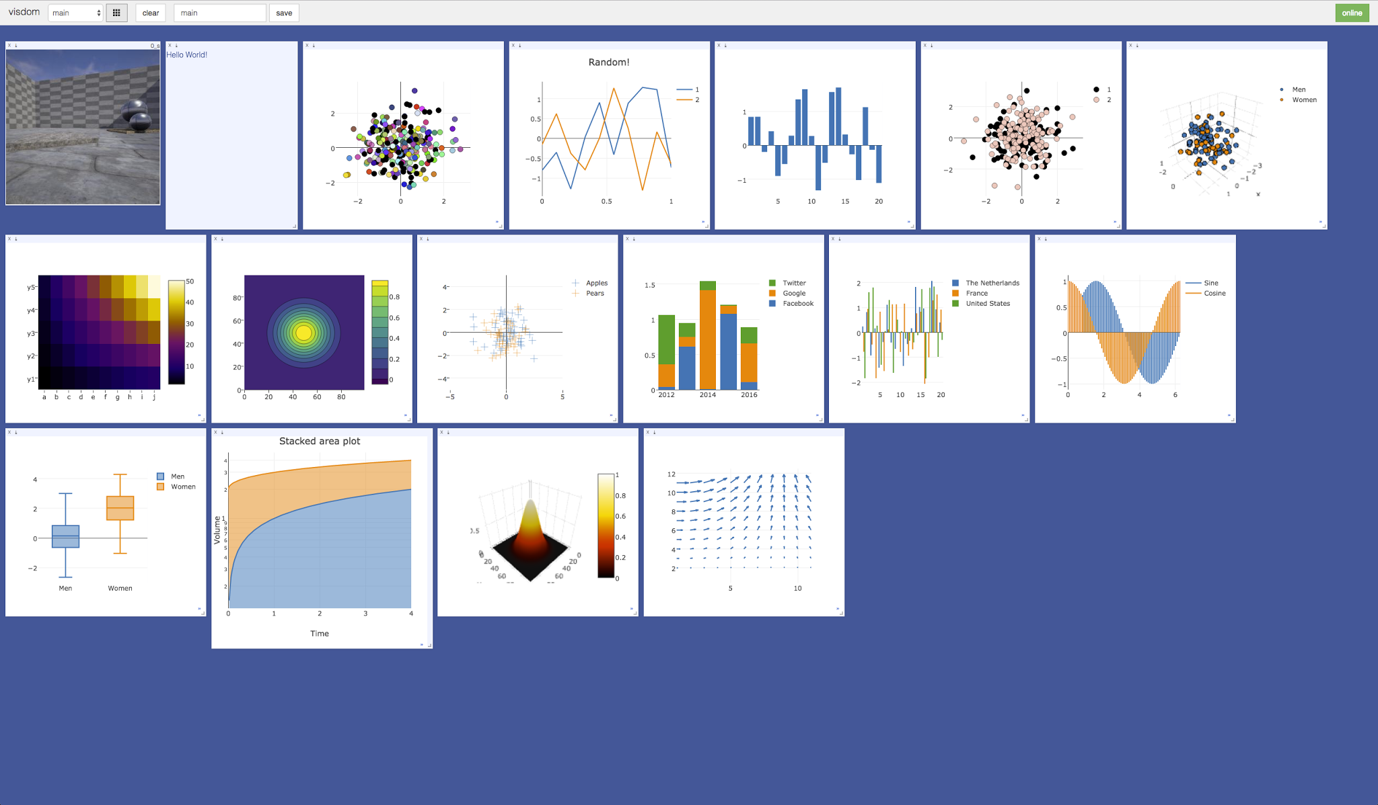
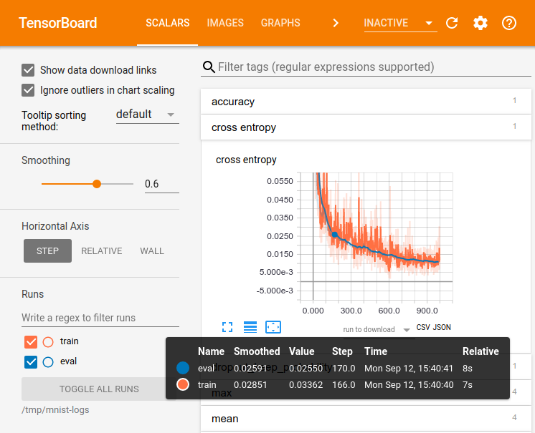
Other resources: visualization
Pytorch-summary
PyTorch Visdom
TensorBoard

Slide 23
Other Resources
Official examples https://goo.gl/Q6Z2k8
Official documents https://goo.gl/gecKC4
Pix2pix code https://github.com/phillipi/pix2pix
Pytorch, Zero to All (HKUST) https://goo.gl/S3vEUN

Slide 24
Structure
Frameworks Overview: why pytorch?
Pytorch: Installation and running
Pytorch: building blocks
Pytorch: optimizer, scheduler and data loader
Pytorch: MNIST step-by-step example
Pytorch: ideal Project structure
Other resources
Tensorflow briefly: MNIST example

Slide 25
Tensorflow briefly: MNIST example
Three levels of tensorflow: primitive, layers, and keras.
Notice similarities to pytorch code. Same steps. Consider the TF code is a much simpler network.
TF code is at a more primitive level.

Slide 26
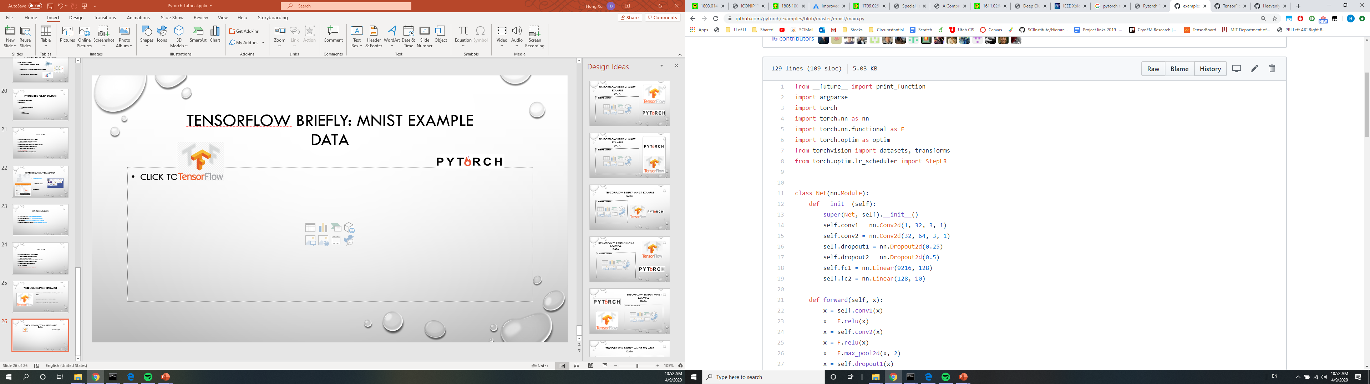
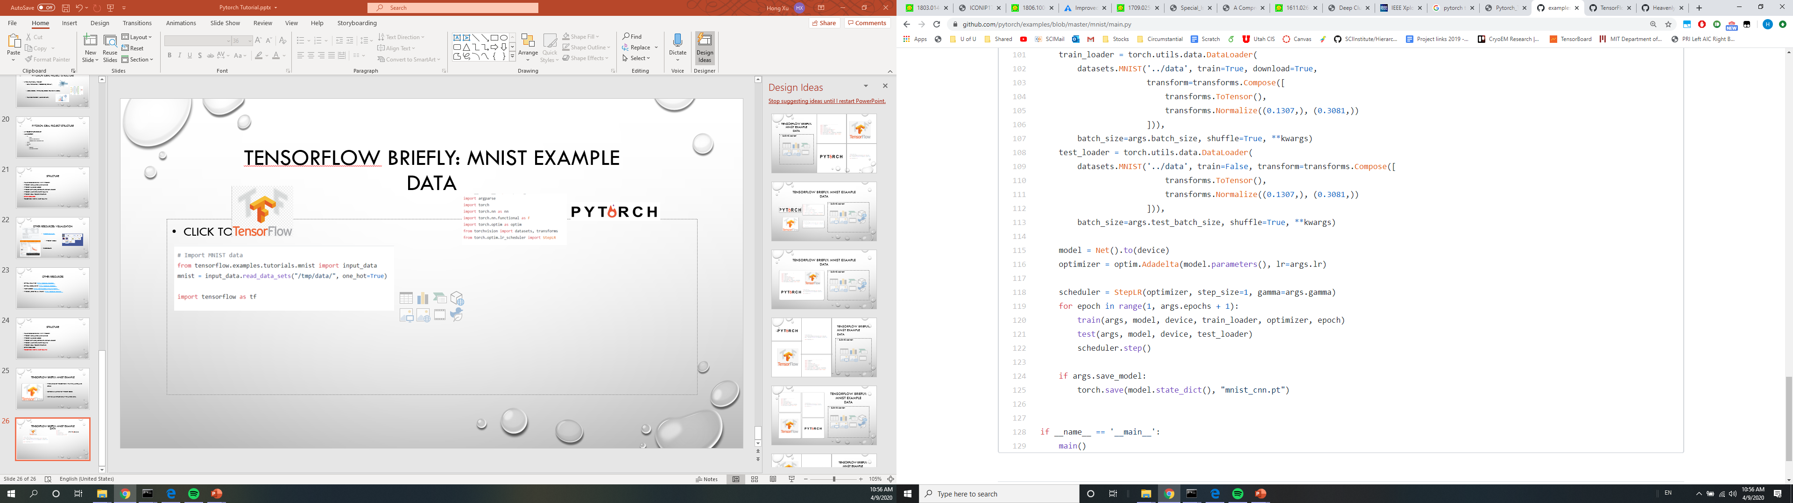
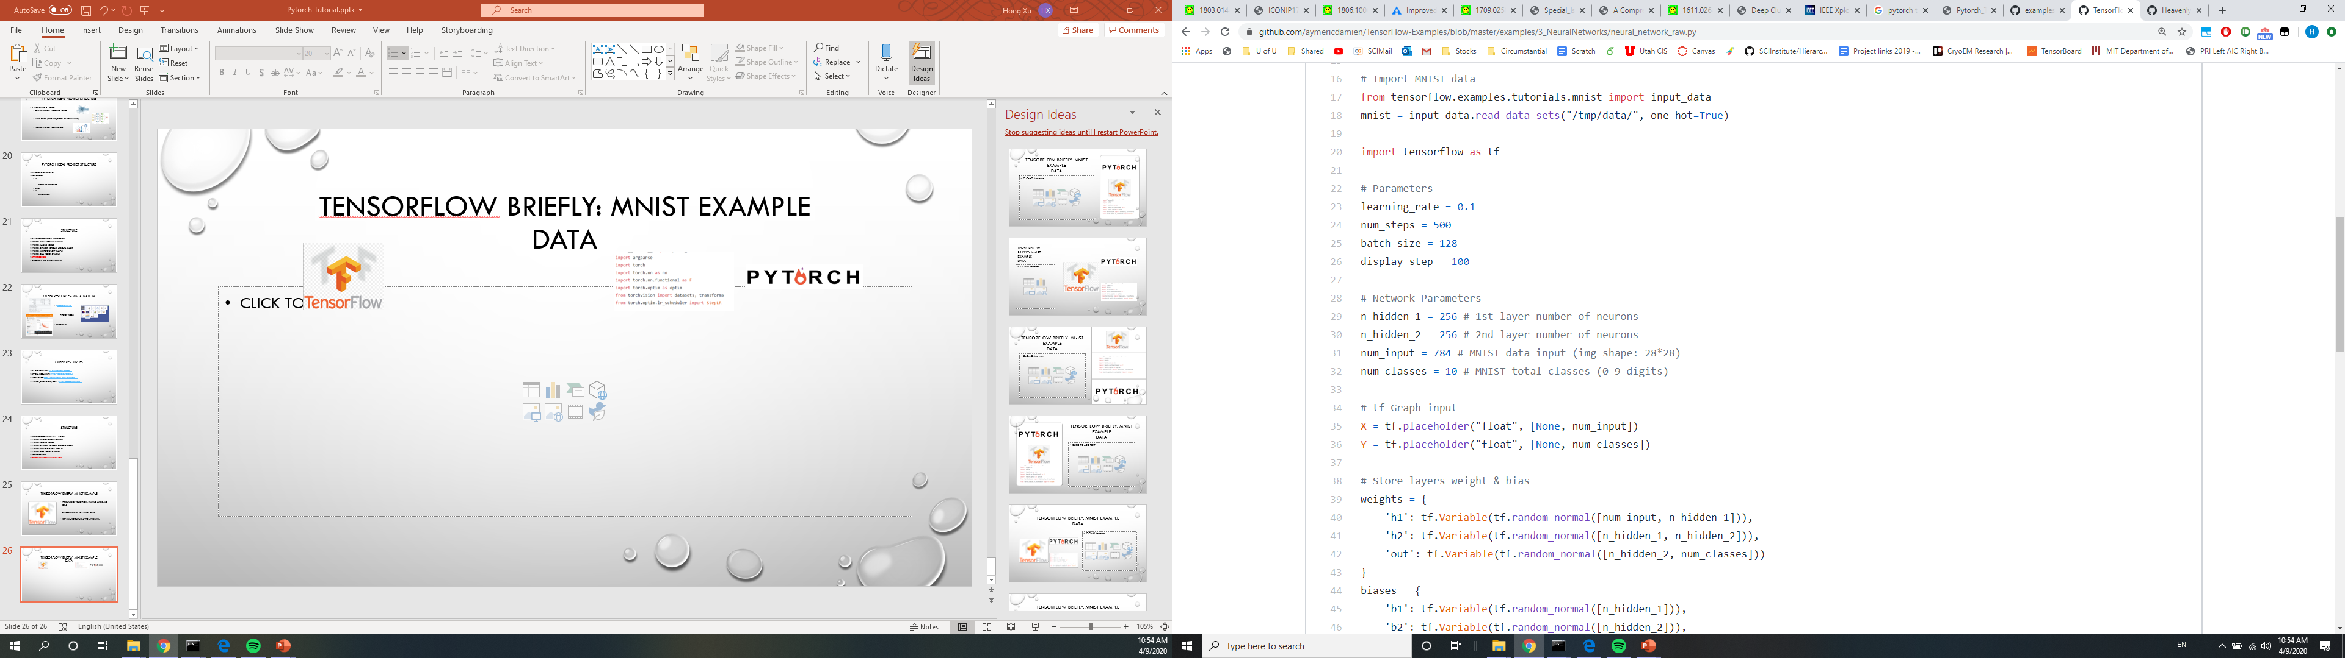
Tensorflow briefly: MNIST example Data

Slide 27
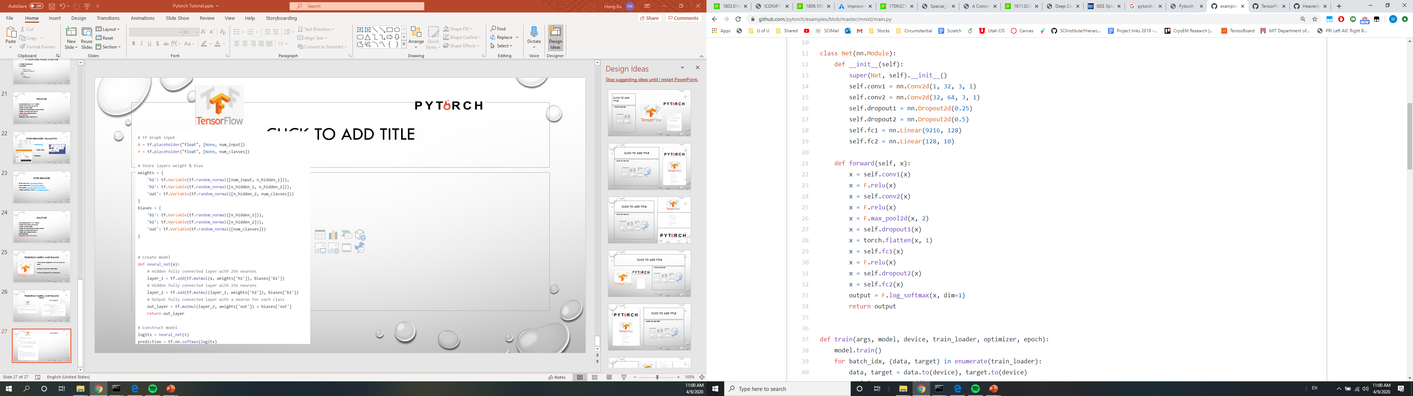
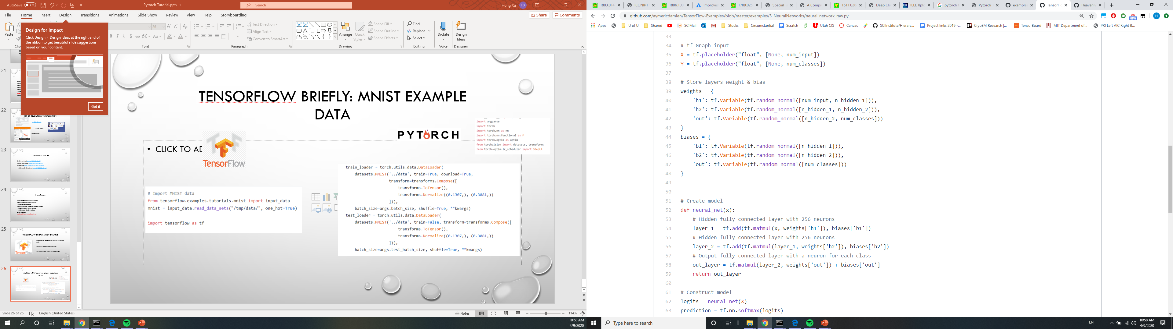
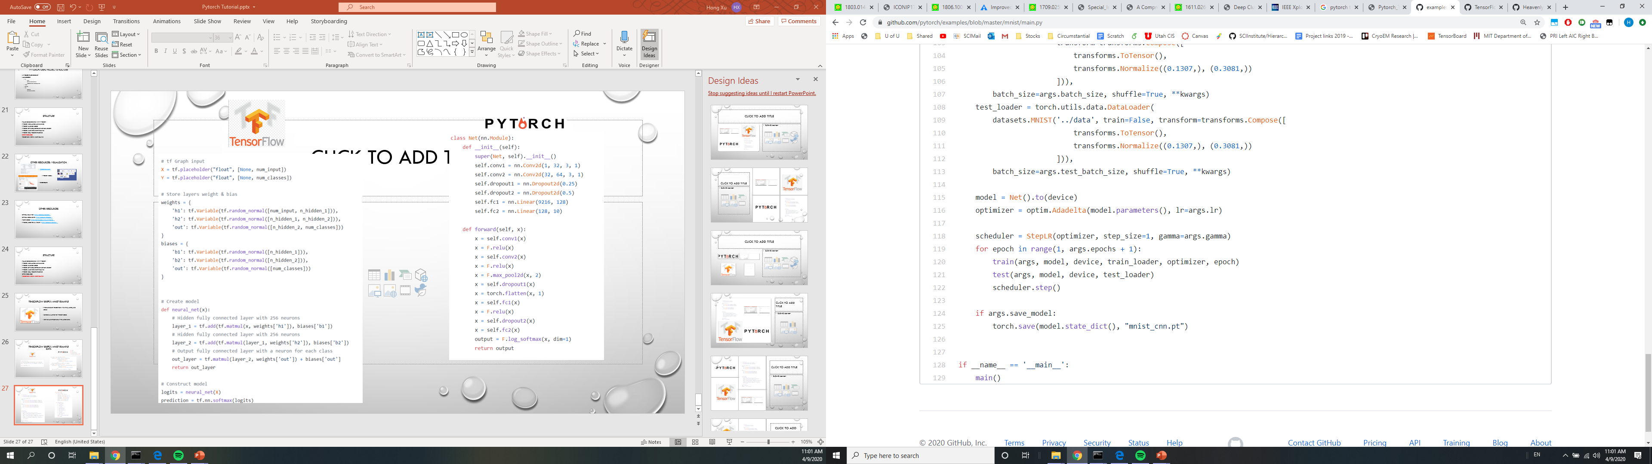
Model

Slide 28
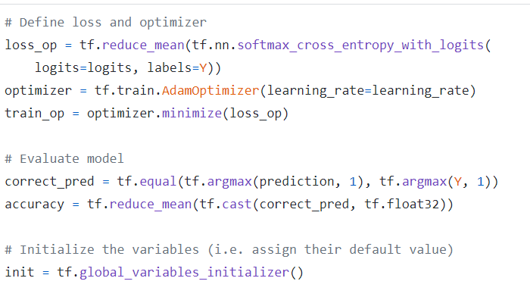
optimizer

Slide 29
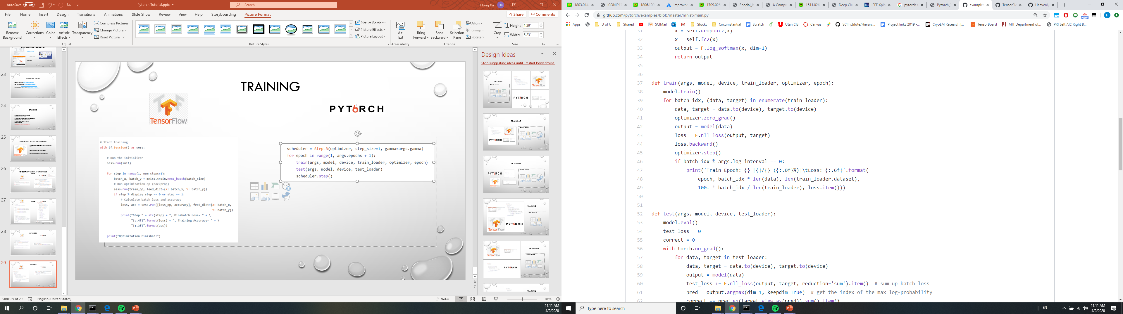
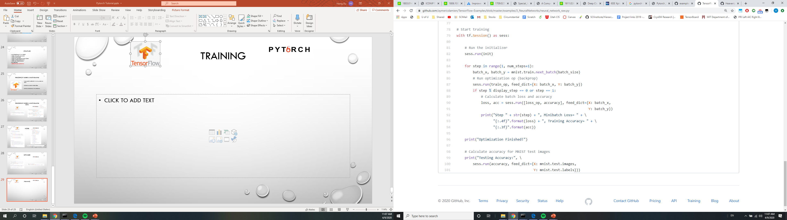
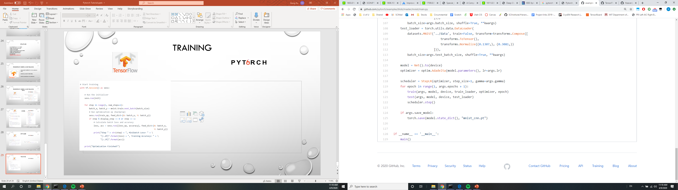
Training

Slide 30
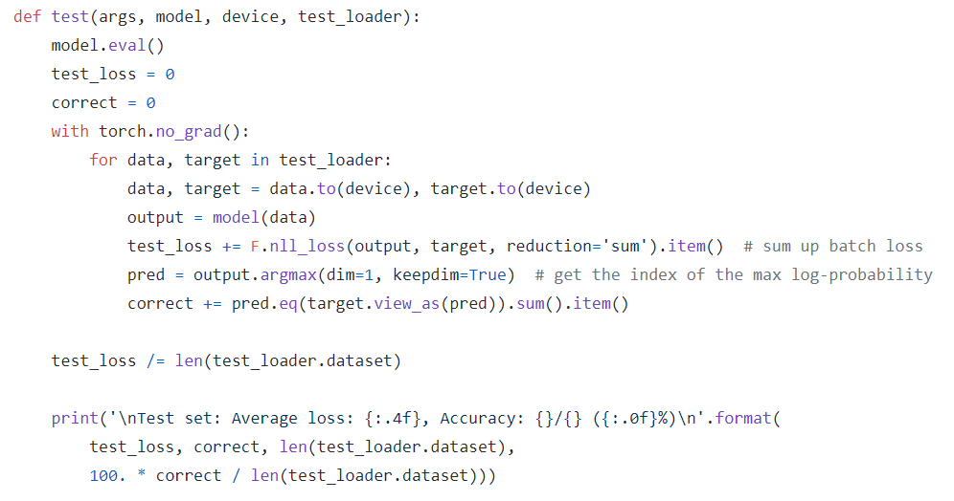
Testing

Slide 31
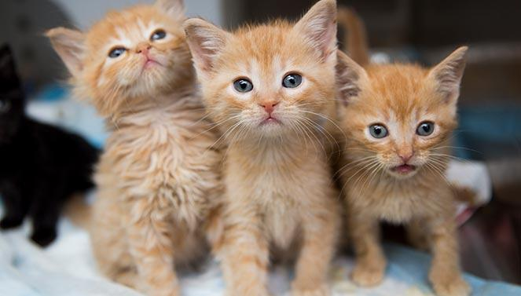

General Questions?

